Slide 1




WORKING
INNOVATION
RFP RESPONSE FOR
DASH CONNECTOR SOFTWARE DEVELOPMENT SERVICES
PREPARED FOR
DROPBOX
SEP 2023
Copyright © 2023 Astreya. All Rights Reserved.

Slide 2
AGENDA
Introduction
Company Overview
Astreya @ Dropbox
Digital Offerings
Our Solution Approach
Execution Model
Success Stories
01
02
03
04
05
06
07
Copyright © 2023 Astreya. All Rights Reserved.

Slide 3







OUR TEAM TODAY
Robert Vaughan
Director – Business Development
San Francisco, USA
Chuck Eggert
Chief Revenue Officer
San Francisco, USA
Balaji Krishna
EVP, Digital Engineering
Seattle, USA
Seth Schaefer
Global Delivery Head
San Jose, USA
Vikram Anerao
VP, Digital Engineering & ERP
Irvine, USA
Rajneesh Chaganla
Data Engineering Leader
Seattle, USA
Copyright © 2023 Astreya. All Rights Reserved.

Slide 4
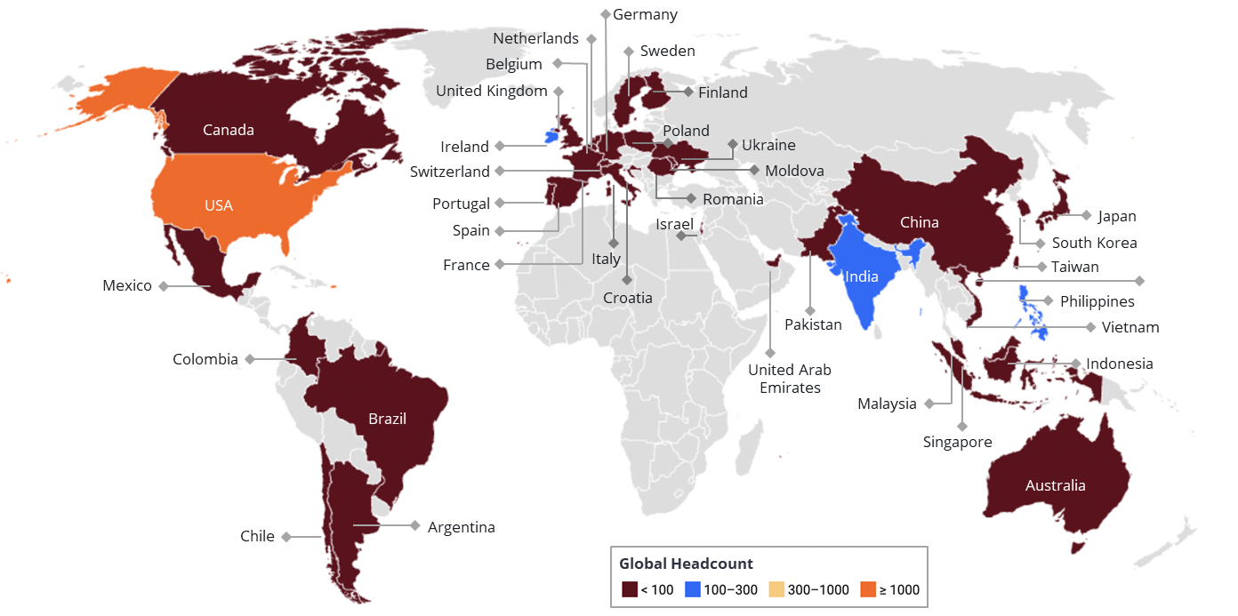


ABOUT US
Company Overview
Founded
2001
Based in Silicon Valley with global delivery & deployment capabilities, we empower top fortune-listed clients with our comprehensive suite of IT Managed Services and NextGen Digital Engineering services for modernized technology ecosystem impacting billions of digital users globally.
Headquarters
San Francisco, CA
34%
95%
15
Y-O-Y Growth
Repeat Business
Fortune 500 clients
8
7+
2200+
50%
40
New clients added in 2022
Years average for
Top 5 customers
Global
Employees
Workforce outside of USA
Countries with local support coverage

Slide 5








WHY ASTREYA?
The Astreya Way – Personalized Partnership
EXPERIENCE
EXPERTISE
COMMITMENT
TALENT FOCUS
WE LISTEN
20+ years' experience in enhancing and delivering Digital Workplace, Infrastructure and E2E Engineering Solutions and Services
Data and Automation driven CX enhancement focus with a deep expertise latest Digital, AI and Workplace Technology Stack
Executive Commitment to Automate; Reduce Cost & Increase Efficiency
Talent Development Availability of SREs/DevOps engineers and consultants with <2% Attrition Rate
We are Right sized - Nimble, Flexible,
Focused & Result
Oriented
Better Customer Experience
Speed and Agility
Reduction in TCO

Slide 6

ASTREYA @ DROPBOX
A True Global Service Delivery Partner
CorpOps (supporting since 2014) - Albert Tang
Tech Infrastructure (supporting since 2021) - Anthony Liu
Data Center (supporting since 2021) - Chris Wesley
CollabX (supporting since 2017) - Neil McMahon
DropStop (11)
Locations: Dublin Ireland & Austin TX
CorpOps Support (5)
Locations: San Francisco, Seattle, New York and Dublin Ireland
AV MCS Engineering, Events, & Production (8)
Locations: San Francisco, Seattle, Austin TX, Arizona & Dublin Ireland
IT Security Management (1)
Locations: San Francisco
Datacenter Support (2)
Locations: Hillsboro, OR
West Virginia
Network Engineering & Automation Tooling (4)
Locations: Columbia, SC & NJ
Site Reliability Engineering (3)
Locations: Madison, Mississippi & Aurora, Colorado + CA
Physical Inventory Operations (5)
Locations: Dublin, Ireland, Maryland,
San Francisco CA
Product Lifecycle Management (1)
Locations: Dallas, Georgia
System Administration (2)
Locations: Dublin Ireland, USA
Identity Management System Administration (2)
Locations: Austin, TX
Knowledge Management (1)
Locations: Orlando, FL

Slide 7
ASTREYA @ DROPBOX
Our Engagement Timeline
2021 (“VIRTUAL FIRST”)
CorpOps Support transitioned
DropStop Managed Services announced
AV Managed Services
Introduced Network / Software Automation & Engineering
Apr Dropbox reduction in force - Apollo completed with minimal interruptions to infrastructure
May Office closures and redistribution of assets. Collaborating to collect and wipe data of of assets completed ontime and in its entirety
Aug AI conference, team focused on producing event. Support and facilitate messaging to get ideas out to the market
Today
PIO is transferring responsibility of a managed service and finalizing agreement
2021 - 2022
2023
2022 Blackbox Event Support and Managed Service awarded, producing internal events for Dropbox
May launched MAX, AI support requests, including password resets, software installations, troubleshooting, and more. We supported training the model
Jun CorpOps Support converting to managed services. Focused on driving projects to completion and experiencing the return on investment
Jul Cloud Admin Support converted to managed services. Focused on projects specific to backend collaboration tools including Slack
Sept Blackbox renewal highlighting messages around AI. AV services expanding to external partners

Slide 8








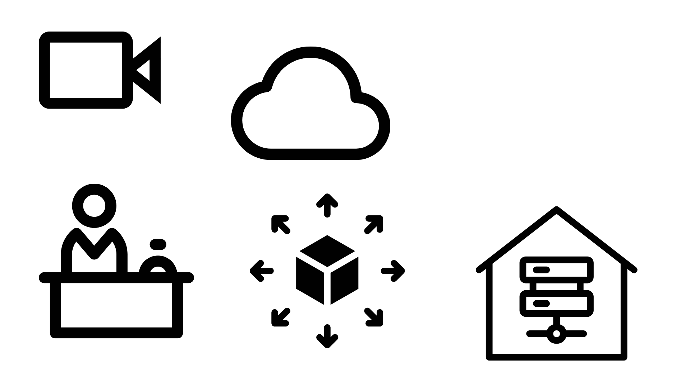

SERVICE OFFERINGS
Our End-to-End Infrastructure and Engineering Services
Rainmakers - 100+ Years of joint experience
200+ Niche Brains in Silicon Valley
Impacting $5Bn+ customer revenue
Solving for Future of IT Infrastructure
Software Engineering
Full Stack Engineering
Digital Integration
Cloud Engineering
DevSecOps
Quality & Reliability Engineering
Hyper Automation
Data Engineering
Data Modernization
AI & Data Science
Data Engineering
Data Management & Integration
BI & Advanced Analytics
NextGen Engineering Services
Persona Storyboarding & UX Planning
Metaverse
Metaverse Advisory
Design & Content Creation
3D Modelling
Service Desk
Network Services
Personal Computing Devices
ITSM
Access Management
Audio Visual
Integration
Maintenance & Break-Fix
Event Support
Help Desk
Digital Workplace & Infrastructure Services
IT Logistics
Material & Allocation Planning
Procurement
Logistics & Fulfillment
PLM
Warehouse Management
Inventory Management
Data Center & Networking
Topology Plan & Design Engineering
Deployment & Provisioning
Monitoring & Operations
Server and Cache Management
Wireless, Backbone & Edge
R&D Lab Builds & Management

Slide 9














DIGITAL OFFERINGS
Next Gen Engineering Services Overview
Rainmakers - 100+ Years of joint experience
400+ Niche Brains in Silicon Valley
Impacting $5Bn+ customer revenue
Solving complex problems for Growing Biz
Software
Engineering
Digital Experience (Web & Mobile)
Full Stack development
UI/UX Engineering
Personas & Experience Journey Mapping
Headless Dashboarding
COTS Customization
Extreme Programming
Digital Integrations & ERP App Dev
EAI & B2Bi Integrations
API Dev Testing & Monitoring
HA & DR Ready Platform Dev
OEM Connector Development
SAP – S4 HANA
SAP – ABAP…
Cloud Engineering
Cloud Strategy & Portfolio assessment
Cloud Agnostic or Cloud Native development (Application, microservices, containers, APIs)
Dev Sec Ops
Cloud Automation - IaaS
Functional Expertise
Supply Chain Management
Production Planning
EWM
Manufacturing
Product Lifecycle Management
Finance
Logistics
CRM
QA & Automation
Test Automation Frameworks
Manual Testing
QA Scripts & Frameworks
Robotic Process Automation
AI/ML based Decision Mgmt. System
Bot Monitoring
Data
Engineering
Data Modernization
Cloud / Hybrid Data Modernization
Data Migration
Data Prep & Curation for AI & Analytics
Data Monetization
Modern Data Architecture Implementation
Artificial Intelligence (AI) & Data Science
AI Labs for Plug & Play
Conversational AI
Machine Learning & Deep Learning
AI led Digital & Business Transformations
AI driven Process Automation
Data Modelling
Data Warehousing
Real Time, Batch and Micro Batch Data Integration
Abbottdata design and Development
Data Processing and Optimization
BI & Data Visualization (PowerBi/Tableau)
Managed Data & Analytical Services
Master Data Management
Customer 360° & Product Master Analytics
Data Management Platform Implementation
Data Quality as-a-service
Run/Operate on Prem & Cloud - DW/Data Lakes/EDW
Metaverse
Metaverse Advisory
Product Strategy
Feature & Use Case Identification
Persona Storyboarding & UX Planning
Platform & Hardware Selection
NextGen Virtual Infra
Design & Content
Creation
Ui/UX Design
Imagery, 360° Video and Spatial Audio
3D Modelling
AR & VR app design
Storyboard and Training Content

Slide 10



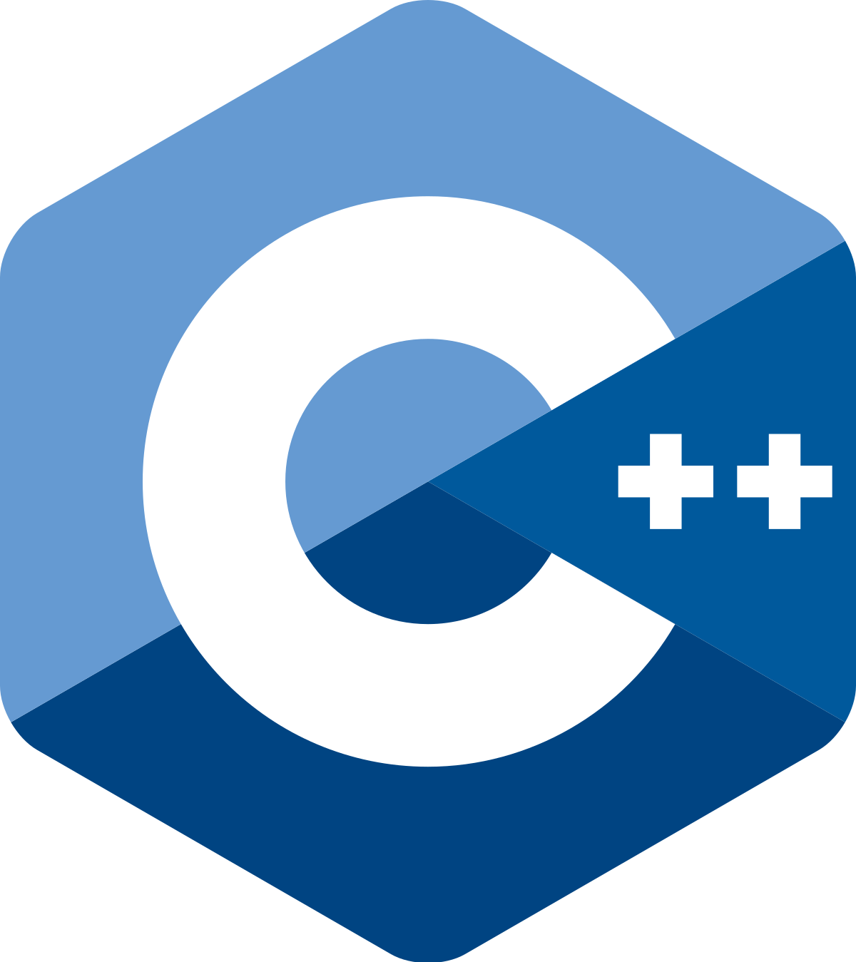

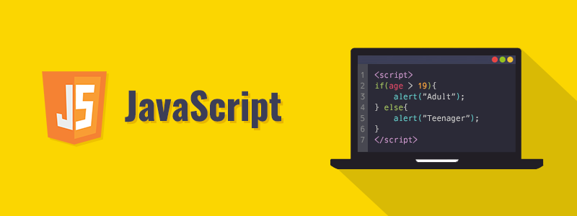










































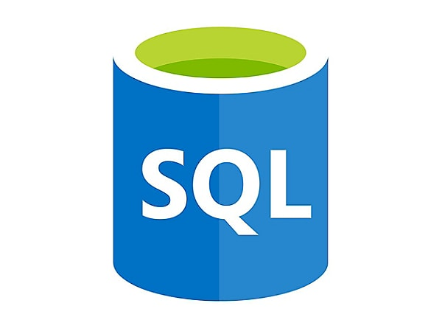

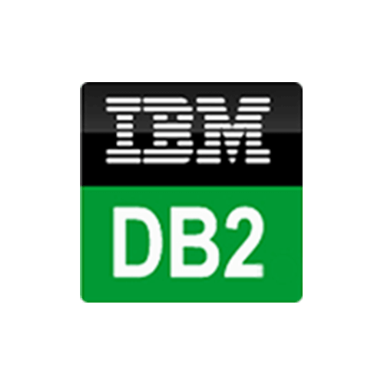










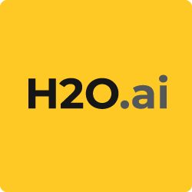







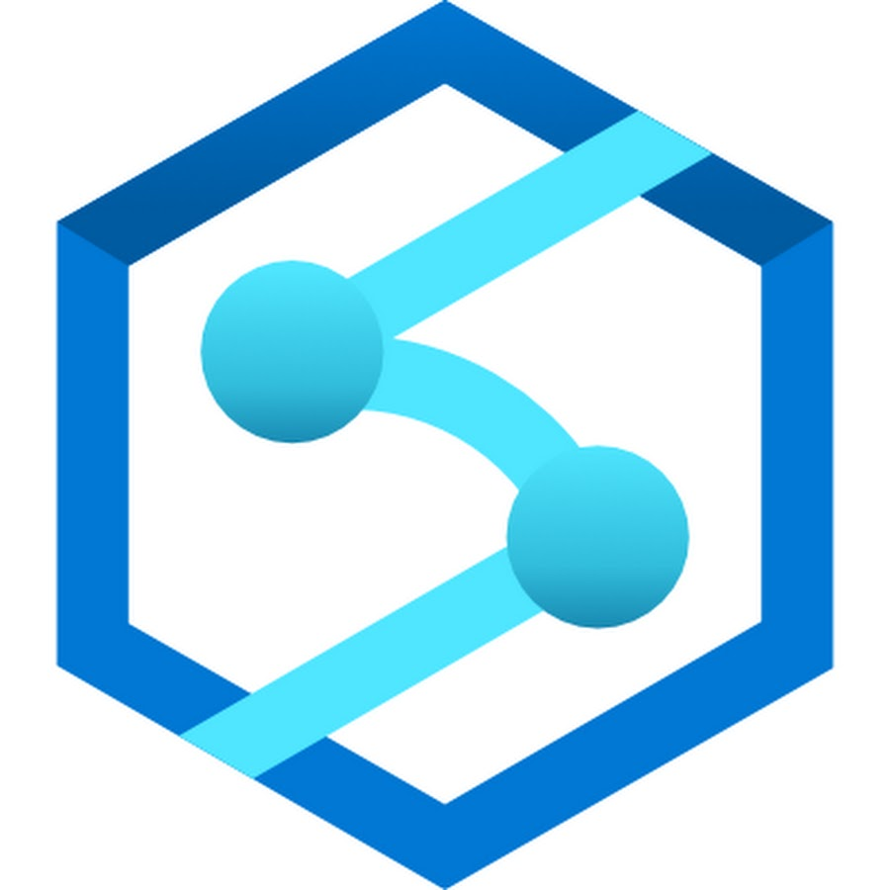

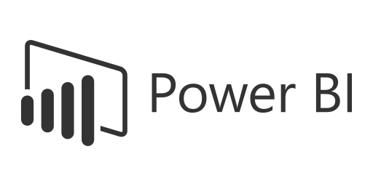
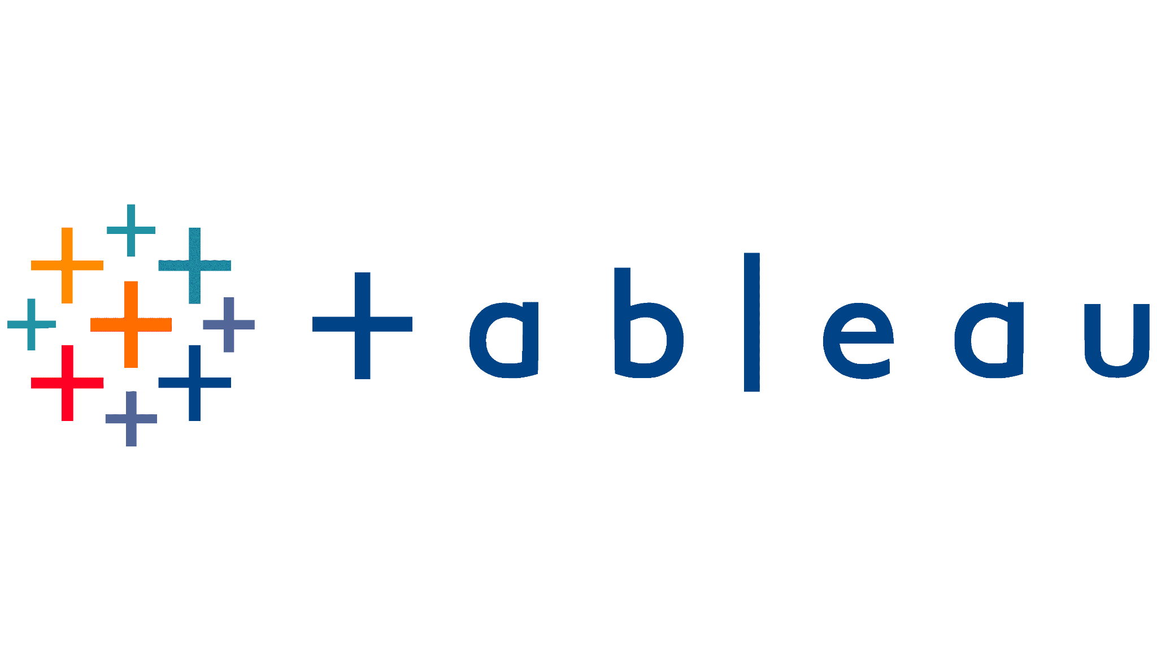








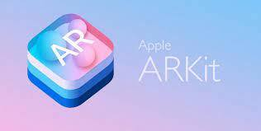










DIGITAL EXPERTISE
Comprehensive Expertise in Latest Technology Stack
Software
Engineering
Programming Languages
Digital Experience (Web & Mobile)
Digital Integration
Cloud Centre of Excellence (CCOE)
Quality & Reliability
Hyper-Automation
Data
Engineering
Data Modernization
Artificial Intelligence (AI) & Data Science
Data Modelling
Managed Data & Analytical Services
Metaverse
Metaverse Advisory
Design & Content
Creation
Virtual App
Development

Slide 11
























DIGITAL INTEGRATION SERVICES
Our Integration and Application Development Service offerings
Mission Statement : “Help organisations to innovate, change & scale faster by making it easy to connect applications, data and devices across all the business domains”
SERVICE OFFERINGS
200+ DIGITAL ENGINEERS
EAI & B2Bi
Customized Solutions
Transaction Visibility & Monitoring-Alerting
HA & DR Readiness
Security & Compliance
iCOE Formation & Strategic Roadmaps
Enterprise Application Integrations
Business To Business Integrations (EDI/EDIFACT)
All Architecture Patterns
Managed File Transfers
Small scale platforms
Large scale platforms
Hybrid platforms
Layered Architectures
Custom Connectors
Ready dashboards & custom dashboards
Self-Service for Biz teams
Pro-active & Reactive monitoring & alerting for Operations & Biz teams
Flex Architecture methodology
Designs to overcome any Disaster Scenario
Designs to ensure Max Uptime
Secured Platforms to process any data
Encryptions for both - in flight & at rest data
SOX Compliant platforms & related consulting
Platforms & Services Maturity model
Strategic Roadmap for iCOE programs
Enterprise-wide Adoption Strategy with Guardrails
20+
IMPLEMENTATIONS
Features & Realized Benefits
Technology Experience
8+
INTEGRATION PLATFORMS / TOOLS
Quicker development cycles with substantial cost savings
Cloud Integration Platforms
Quicker connectivity with connectors means shorter time to market launch
Efficient business process management with lesser downtimes for applications
Traditional Integration Platforms
KPI Monitoring for business transactions
300+
INTEGRATION INTERFACES DELIVERED
Scalability of the platforms can support any amount of load with guaranteed delivery
Messaging & Event based Platforms
‹#›

Slide 12
DIGITAL INTEGRATION SERVICES
Complete List of Integration Services Offerings
Services/Benefits of Integrations | What it means to IT | Benefits to Biz Teams/Business Driver
Low Code Cloud based integration development platform for Data Transformation | Widget based development style enables developers with smaller development cycle | Lesser development effort with substantial cost savings & shorter time to market for any solution
Quick Connectivity to any application | 200+ Out of the box Boomi Application & Technology Connectors can quickly connect with any application | Quicker connectivity means shorter time to market for any solution
Messaging Channel/Routing (Pub Sub) | Multiple apps subscribe to same message published by one publisher without the need for publisher to deal with each subscriber | Common business artifacts (Canonical) can be utilized for multiple applications with minimal changes
Loosely Coupled Channel (Asynchronous) | Decoupling of the business process reduces Outages for multiple Applications | Efficient business process mgmt with lesser downtimes for business applications
Data Persistence | Ability to store data and reprocess as and when needed | Guaranteed delivery of business artifacts
Business Transaction Visibility | Self Service Dashboards for business stakeholders & operations teams to monitor business processes and payloads | Quicker resolution time for critical business transaction failures with domain specific KPI monitoring
Monitoring & Alerting | Platform components and critical business transactions are monitored with automated alerts | Proactive monitoring and alerting ensures continuous availability of platform & continuity for business
Highly Available Platform with Flexibility feature | Flex architecture platform scales up & down to accommodate huge volumes | Business continuity with timely processing of data for business
DR (Disaster Recovery) Ready Platform | Ability to handle any disaster scenario through continuous data sync to standby infra-platforms in other region of AWS | Business continuity without data/transaction loss for business
Large files/data processing | Platform is capable of handling large files using MFT framework and huge data processing with thread mgmt | Data of any size and format can be processed and transferred from one app to another
External Trading partners/B2Bi services | Platform uses IBM VAN to register Rivian’s vendors/suppliers for exchanging EDI business artifacts | Supply Chain and Logistics business is run by this functionality of EIH
Security Services | Data encryption, encryption at rest, API Security | Secured platform for business, it will be SOX Certified
*Quality Control & Testing Services | Unit testing for Boomi/Integration code and test automation features for biz use case testing | Lower code quality issues and related changes, improving biz process continuity

Slide 13




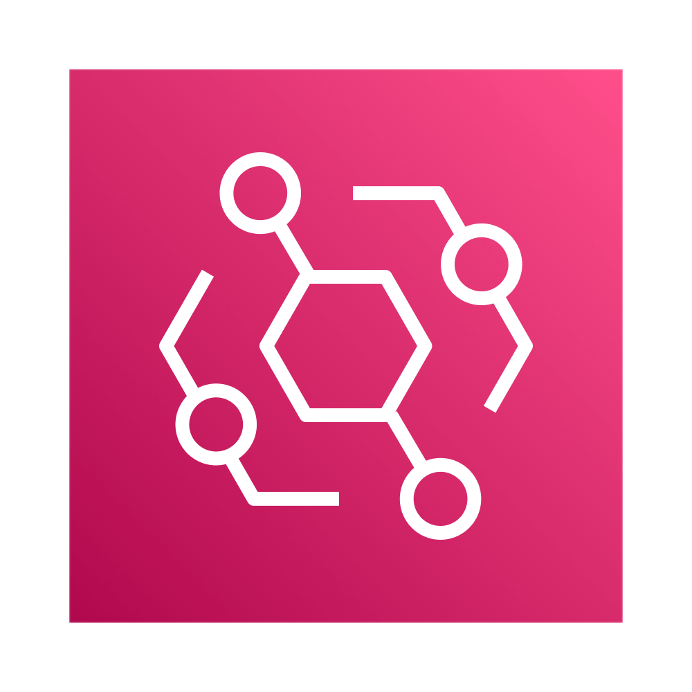
ASTREYA APPROACH – CONNECTOR DEVELOPMENT
Dash Connector Pilot – Solution Architecture
SOLUTION HIGHLIGHTS
Pilot Hosted in AWS
Kinesis used for Metadata Triggers
Lambda 1 used for –
Polling for incoming files at Dropbox Folder at specific intervals
Extracting the Metadata of the files
Sending Metadata to Kafka topics
Lambda 2 –
Gets triggered with incoming Metadata in Kafka topic
Based on the the Metadata of the file, it fetches the files and moves its content to S3 bucket
Same Metadata could be sent to Dash
From Dash UI, end users can do the search for files
Kinesis Cluster with HA
Box
Metadata
Producer
Subscriber
OAuth 2.0
File Content
YAML Config
Metadata
Trigger
OAuth 2.0
AWS Lambda
(Scalable Micro Service)
BOX
Amazon EventBridge
AWS Lambda
(Scalable Micro Service)
Notes:
LogicMonitor - agentless
Start with audit
Placement of monitor/server
Ebay - open source package, observian
DR test/simulation

Slide 14
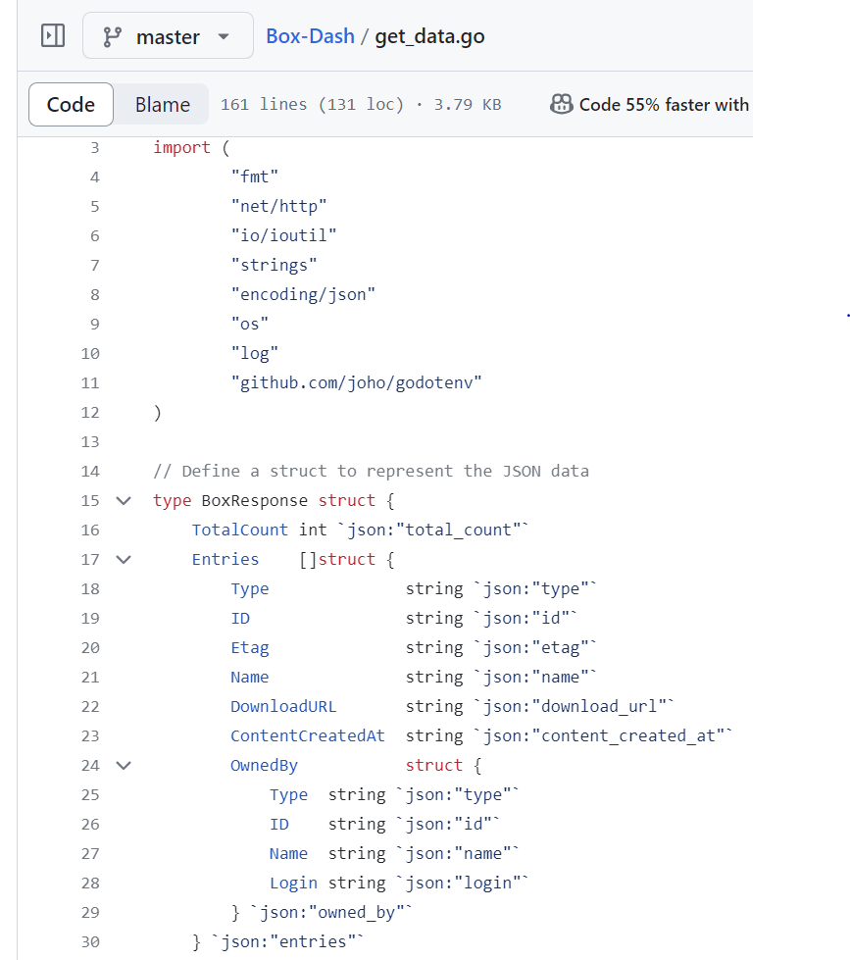
DEMO
Connector Mock Code / Demo

Slide 15
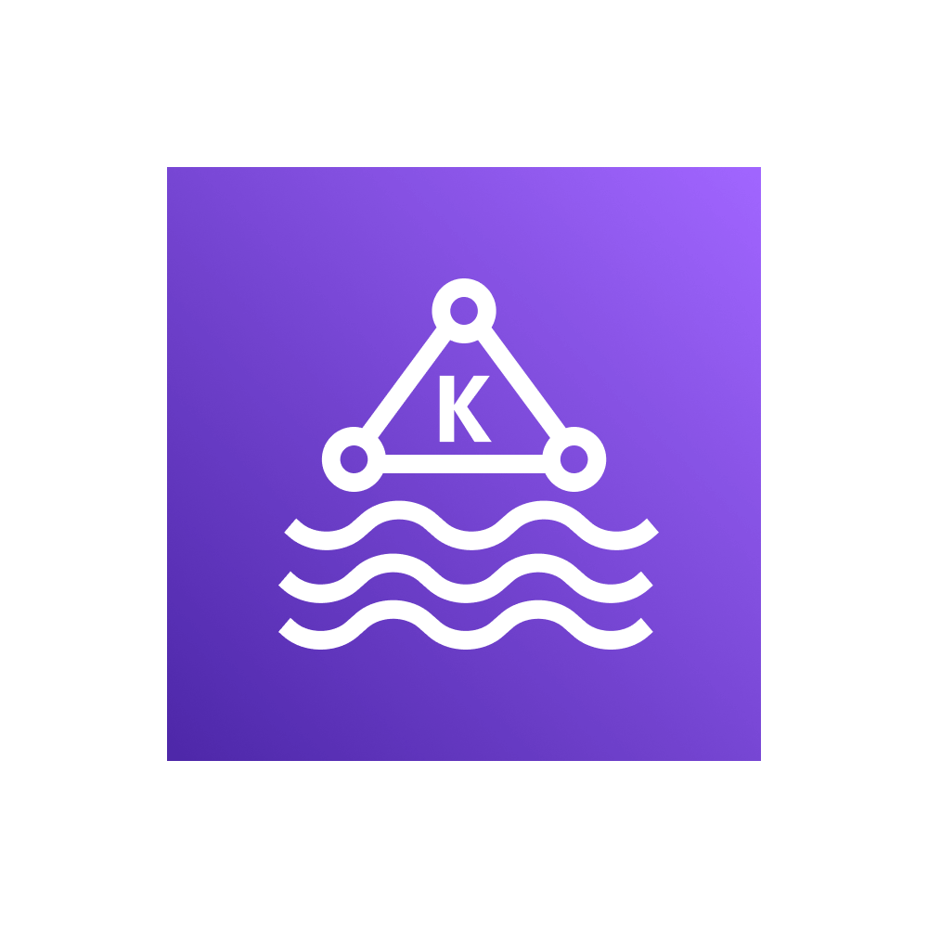


ASTREYA APPROACH – CONNECTOR DEVELOPMENT
Potential Improvements and New Features
File Archival
Kafka/Kinesis Cluster with HA & DR
Box
Metadata
Running Lambda in a container in cluster of Kubernetes, to scale the execution with Pods multiplying in case of Volume
Dropbox folders can grow, and we can use the same connector code to scale up to any number of folders to pick the files by making the solution YAML config based
Making Kafka/Kinesis run in HA mode
Improved Error handling with monitoring & alerting
Archival of the files to Archive Dir once they are picked up and moved to S3 bucket (if needed)
Producer
Subscriber
OAuth 2.0
File Content
Metadata
Trigger
OAuth 2.0
AWS Lambda
(Scalable Micro Service)
Scalable Pods
BOX
Scalable Pods
Amazon EventBridge
AWS Lambda
(Scalable Micro Service)
Notes:
LogicMonitor - agentless
Start with audit
Placement of monitor/server
Ebay - open source package, observian
DR test/simulation

Slide 16


























ASTREYA APPROACH – SOFTWARE DEVELOPMENT
DevOps Pipeline & Toolchain - AWS
Source Code Management
Build Tools
Unit Testing
Code Quality Analysis
Store valid binaries, packages
Check-out code
Validate Builds
Check out code and build
Unit Testing
Quality Control
Daily Build/Packaging and Archiving
Fetch Latest Build/Artifact
1
2
3
4
5
Continuous Integration
11
10
9
8
7
6
Deploy to Production Environment
Acceptance Testing
Deploy to UAT Environment
Fetch Release ready Builds
Functional Testing
Deploy to QA Environment
Monitoring and Analytics Tool
Configuration Management and Deployment Tools
Testing Frameworks
Test
Pre-Production
Production
Deployment Environment
Notes:
LogicMonitor - agentless
Start with audit
Placement of monitor/server
Ebay - open source package, observian
DR test/simulation

Slide 17








SUCCESS STORY
Geo Information System Application Development
Business
Problem
Manage global telecom infrastructure and assets for expanding dark fiber networks in North America.
Lack of accurate asset and geospatial data to create comprehensive asset databases and detailed maps for network planning and maintenance.
Long lead times to plan, design and build physical infrastructure.
Implemented Solution
Full stack development of web application using React.js front end with PostgreSQL database for a high-performance application.
AI based Geospatial data integration and analysis to provide real-time visualization of geo features and fibre route plan recommendations
Cloud based CI/CD platform for development environment with testing framework and tooling to support iterative builds.
VR modelling of physical infrastructure allowing remote teams to design, construct, and support equipment huts to exact specifications.
CLIENT
MOST POPULAR SOCIAL NETWORKING PLATFORM IN THE WORLD
Delivered Benefits
Minimum viable product in production within six months
Open source development to increase portability and reduce cost
Increased data quality for route, circuit and network asset management
Higher user satisfaction with advanced front end technology to visualize and plan global network infrastructure
TECHNOLOGY
Notes:
LogicMonitor - agentless
Start with audit
Placement of monitor/server
Ebay - open source package, observian
DR test/simulation

Slide 18



SUCCESS STORY
Semantic Model for Content Management System
Client had been gathering data for their global health programs from various sources in different forms since 2000. Handling and processing large datasets in multiple formats from different applications has been a challenge due to poor data quality and unavailability of real time insights
Business
Problem
Implemented Solution
Built robust workflow based semantic model for data indexing and categorization for enterprise content and real-time uploads
Utilized OpenAI for image segmentation which in turn adopts foundation models for NLPs
Utilized capability for users to select objects for segmentation interactively, employing bounding boxes, key points, grids or text prompts
To speed-up the process for file comparisons and validations, implemented RPA automations and eliminated manual interventions
Integrated multiple AI based use cases with enterprise portals, enterprise search and client social media accounts
CLIENT
GLOBAL NON-PROFIT ORGANIZATION
Delivered Benefits
Cut down considerable amount of effort in time and cost for content processing and categorization.
Users are able to generate content interactively based on specific themes
Minimized the processing times by automating the content sharing and integration processes.
Metrics dashboards provide deep insights based on the Image and file processing
TECHNOLOGY
Notes:
LogicMonitor - agentless
Start with audit
Placement of monitor/server
Ebay - open source package, observian
DR test/simulation

Slide 19







SUCCESS STORY
Collaboration Tools Integration
With many scattered and redundant collaboration tools available to employees at the fast-moving technology company there was no seamless employee experience for collaborating between technology and product groups. Additionally frequent acquisitions caused the environment to be further disjointed for newly added team members.
Business
Problem
Implemented Solution
The Astreya team assembled a team of digital engineers to administer tools, develop backend integration and automate business processes to support a seamless employee experience using collaboration tools.
Customized access provisioning workflows to securely administer users on all collaboration tools.
Deployed Slack bots to handle employee requests for system access, hardware accessories, and other onboarding needs.
Automated migration flows to merge collaboration platforms and user accounts with newly acquired organizations.
CLIENT
Popular File Hosting Service Provider
Delivered Benefits
Reduced average time to resolve service requests for collaboration tools by 60%
Increased efficiency for onboarding newly acquired organizations by shortening the process from months to weeks.
Improved employee experience by providing a one stop shop for access provisioning.
TECHNOLOGY
Notes:
LogicMonitor - agentless
Start with audit
Placement of monitor/server
Ebay - open source package, observian
DR test/simulation

Slide 20
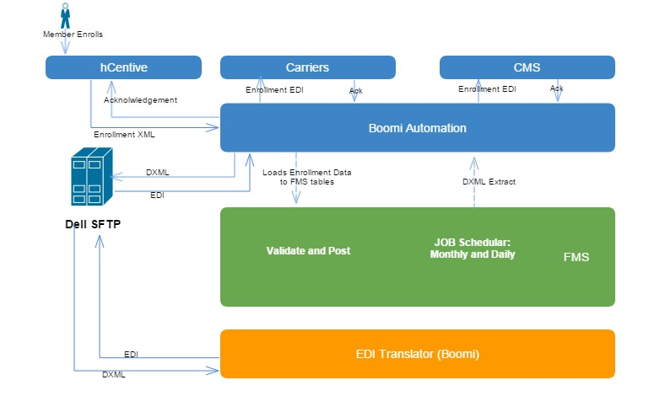
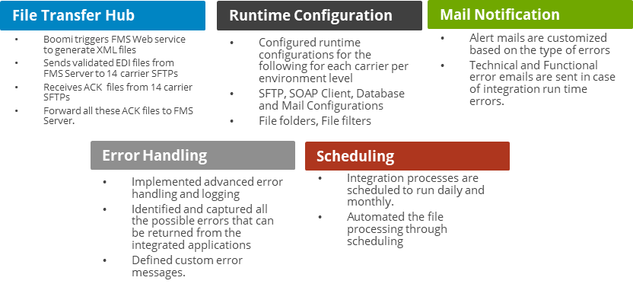


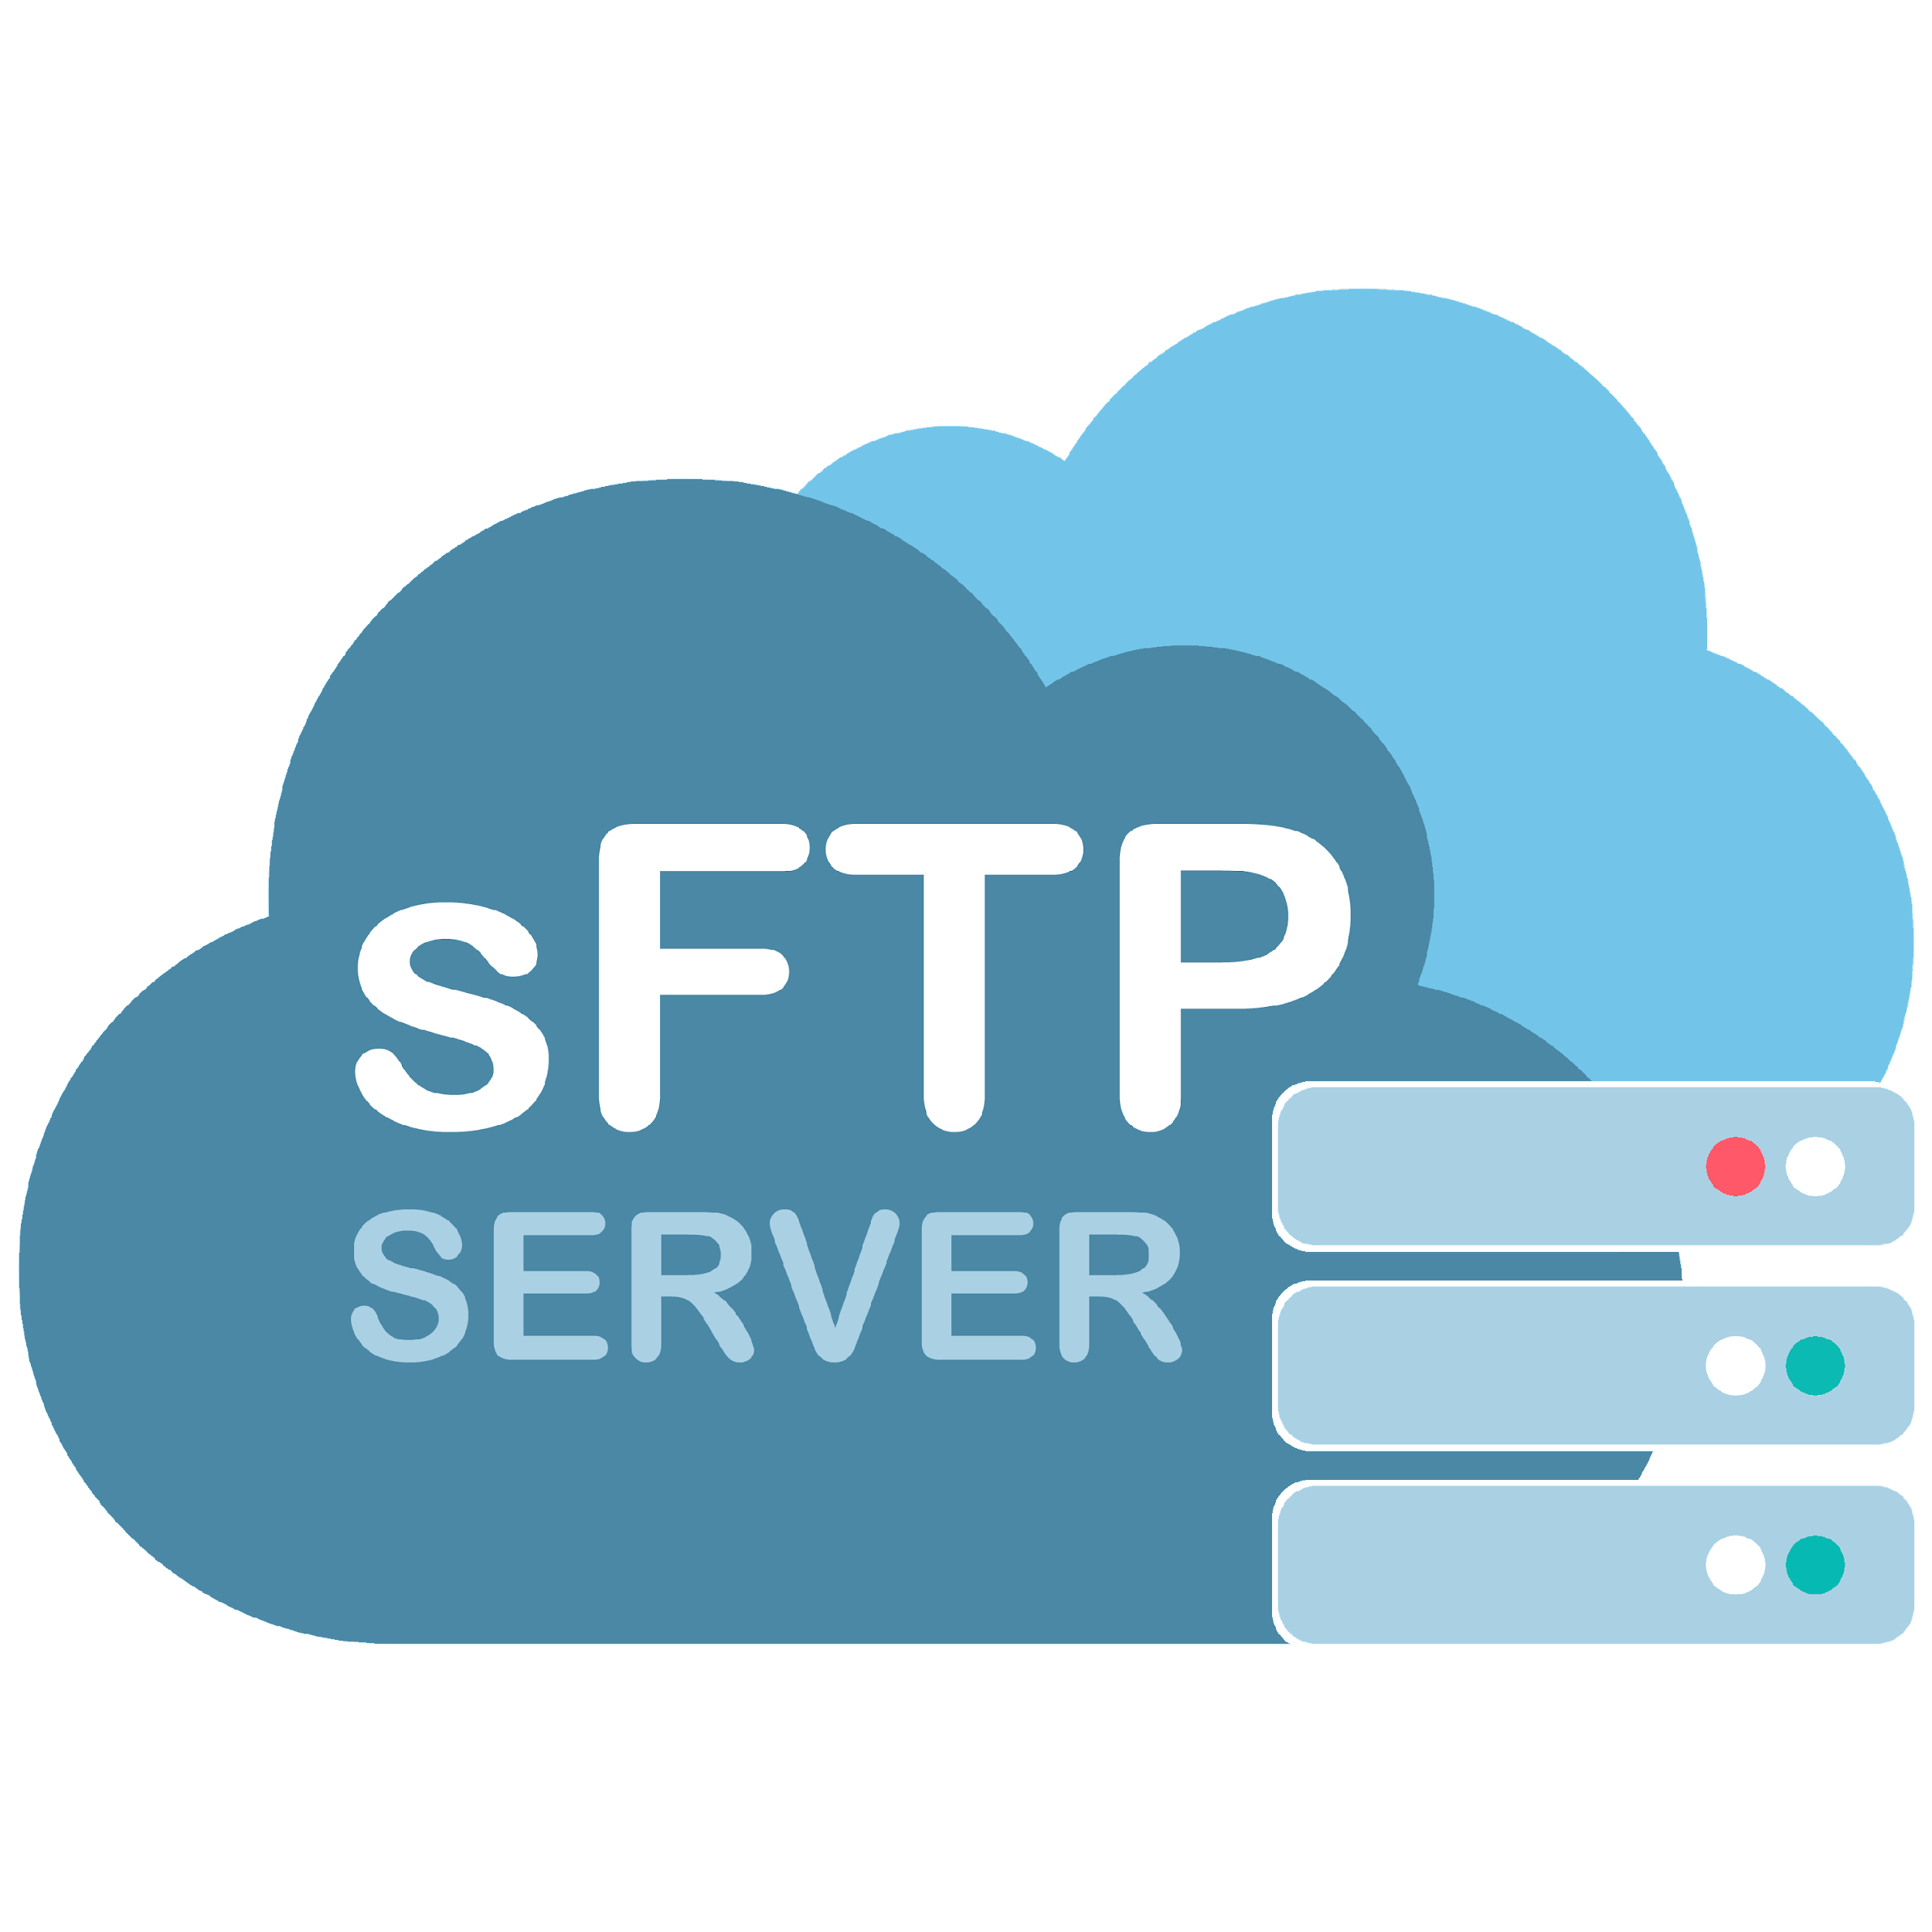
SUCCESS STORY
Healthcare Connector Development using Boomi
Client provides quality health insurance plans through multiple carriers due to which the data flows between internal applications and external carriers. Customer needed an easily configurable and reliable mode of communicating with the carriers using secure SFTP
Business
Problem
Implemented Solution
Boomi is implemented as a total EDI Integration and File transfer hub.
It triggers FMS web service to generate XML files; sends validated EDI files from FMS Server to carrier SFTPs; Receives ACK files from carrier SFTP and forward them to FMS server
SFTP
CLIENT
US BASED HEALTH CARE INSURANCE PROVIDER
TECHNOLOGY
Delivered Benefits
Delivered the entire solution through Global Delivery model with over 60% cost savings
Reduced human errors by 80% with implementation of Connector
Notes:
LogicMonitor - agentless
Start with audit
Placement of monitor/server
Ebay - open source package, observian
DR test/simulation

Slide 21

THANK YOU
LET'S GROW
TOGETHER
HEAD OFFICE
FOR QUERIES @
655 MONTGOMERY STREET
STE 490 DPT# 17117 SAN FRANCISCO, CA 94111-2635
ROBERT VAUGHAN
DIRECTOR, BUSINESS DEVELOPMENT
rvaughan@astreya.com

Slide 22
SUCCESS STORY – LARGEST BEVERAGE MANUFACTURER
Eng Apps Development & QA Global Delivery Execution Model
)
Client and Astreya Steering Committee (Engagement Reviews & Performance Measurement)
DEV & QA Nearshore Team – 4:30 AM to 12:30 PM PST
Manual QA Engineers
PST 4:30 AM to 12:30 PM
QA Team (70% Nearshore)
Manual and Automation Engineers
Main Tasks
Story Points Execution, Writing Test cases, Automation Scripts, Defect Tracking & Reporting
Test Automation Engineers
Nearshore Shift
Full Stack Developers
Eng. Apps Development Team
(25% Nearshore)
Rotation of resources on need basis + Main Tasks
New features development and on-call support with bi-weekly rotation within the team
Front End Developers
Back End Developers
Handshake between Nearshore & /Onsite Teams
08:30 AM PST- 12:30 PM PST
DEV & QA Onsite/ and Nearshore Team – 8:30 AM to 05 PM PST
Front End Developers
Eng. Apps Development Team
(75% )
Rotation of resources on need basis + Main Tasks
New features development and on-call support with bi-weekly rotation within the team
Back End Developers
PST 8 : 30 AM to 5 PM
Full Stack Developers
PST Shift
QA Team (30% Onsite)
Eng. Apps QA Lead in PST
Main Tasks
Review work done by Nearshore team, Work with Prod Managers and Dev team for QA delivery in PST, Send new work to Nearshore
1 QA Lead – Covering Test Automation + Manual Testing
UX/UI Designers
Software Development
Quality Assurance
CoE (Best Practices & Guidance)
Astreya Team
Roles available in Shift

